Slide 1
Introduction to ChatGPT
Level 6+
YURI GUSHIKEN

Slide 2
Your place in the world
Who can you identify in this picture?
What do you think you have in common with these people?
Artificial Intelligence is the great equalizer (or the second great equalizer)
Your ability to benefit from humanity’s greatest creation is only as good as your ability to use it
Notes:
Great equalizer – education - reducing inequalities and promoting social mobility.
Dismantle entrenched inequalities, unlock social mobility.

Slide 3
ChatGPT
What can ChatGPT do?
What can GPT-4 do?

Slide 4
Prompt 1
I want you to act as an academician. You will be responsible for researching a topic and presenting the findings in an outline. Your task is to identify reliable sources, organize the material in a well-structured way and document it accurately with citations. My first suggestion request is “I need help writing an article on Captain James Cook's second voyage targeting people not interested in history.”
Academician
An outline for an article/essay/paper
Intro
body sections
conclusion
Sources
Note: For this exercise, choose a topic you are familiar with

Slide 5
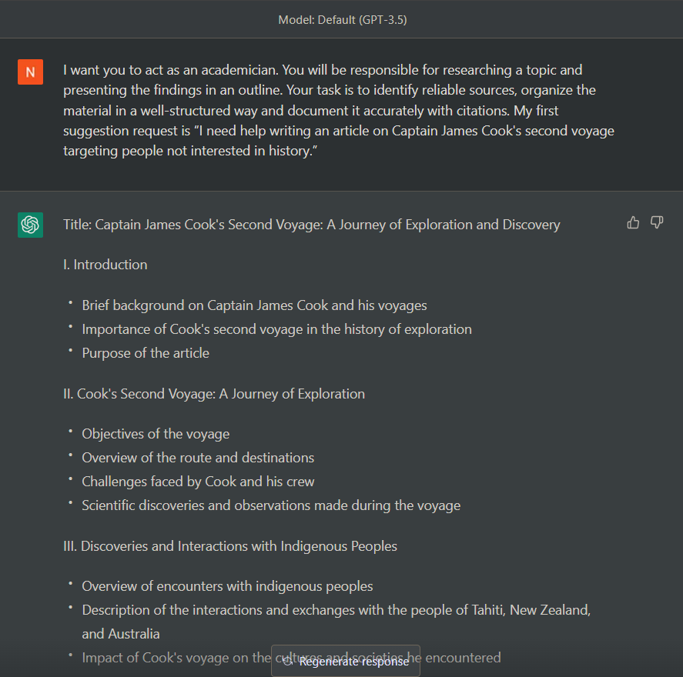
Prompt #1
1st output

Slide 6
Prompt #1
Please write the paragraph for part 1 of section 2
(depending on outline format, wording may vary)

Slide 7
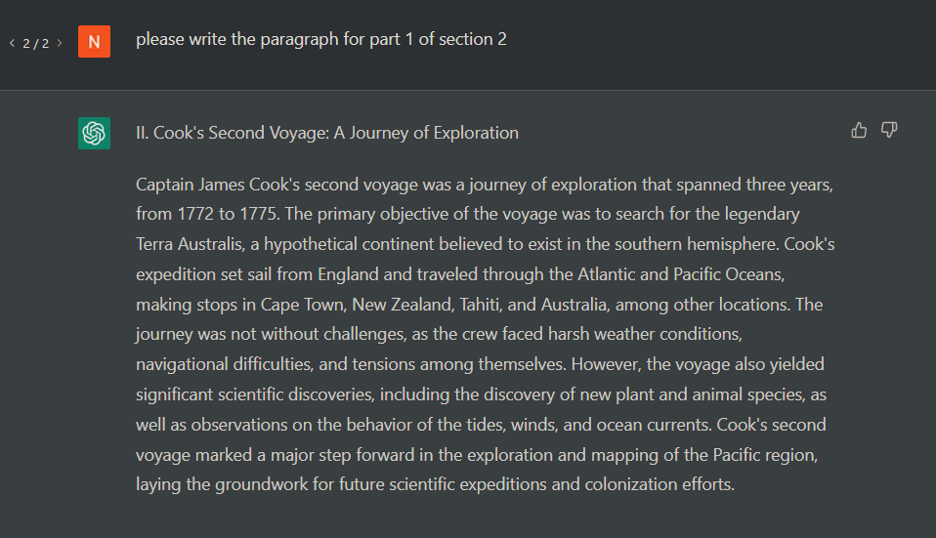
Please write the paragraph for part 1 of section 2
(depending on outline format, wording may vary)

Slide 8
Prompt 2
When it comes to writing content, two factors are crucial, "perplexity" and "burstiness." Perplexity measures the complexity of text. Separately, burstiness compares the variations of sentences humans tend to write with greater burstiness, for example, with some longer or complex sentences alongside shorter ones. Al sentences tend to be more uniform. Therefore, when writing the following content, I am going to ask you to create, I need it to have a good amount of perplexity and burstiness. Do you understand?
“Perplexity” and “Burstiness.”
A two-part prompt
A writing improver
ChatGPT: Yes, I understand…
Using the concepts written previously, rewrite this article with a high degree of perplexity and burstiness: (paste your paragraph)

Slide 9
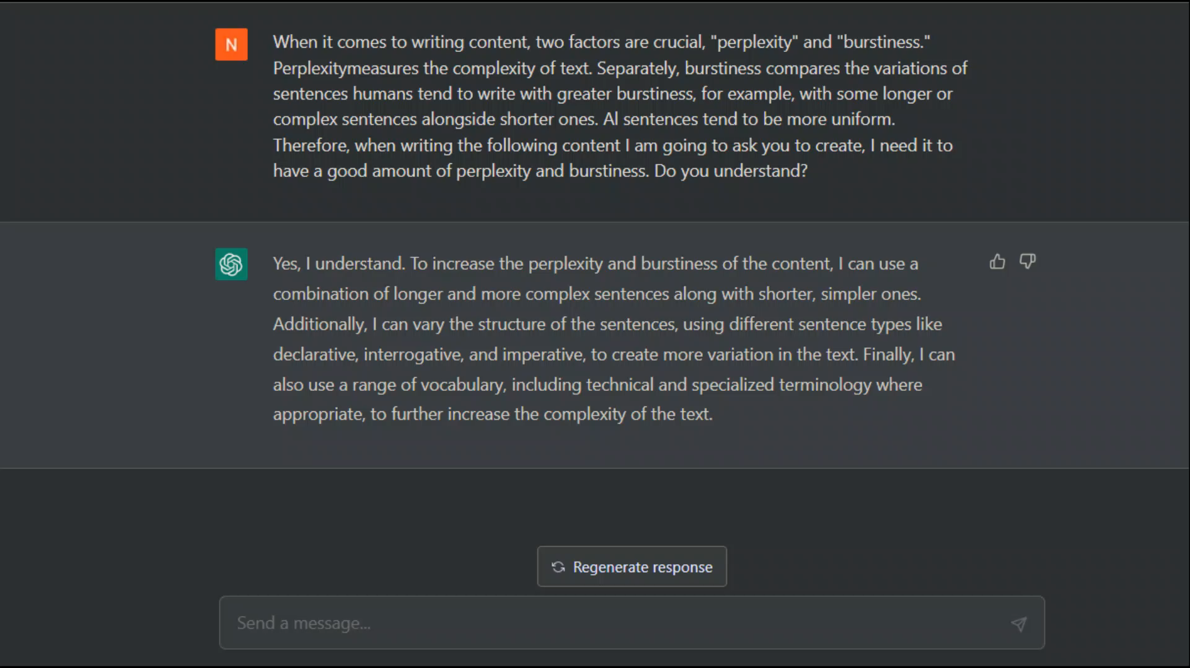

Slide 10
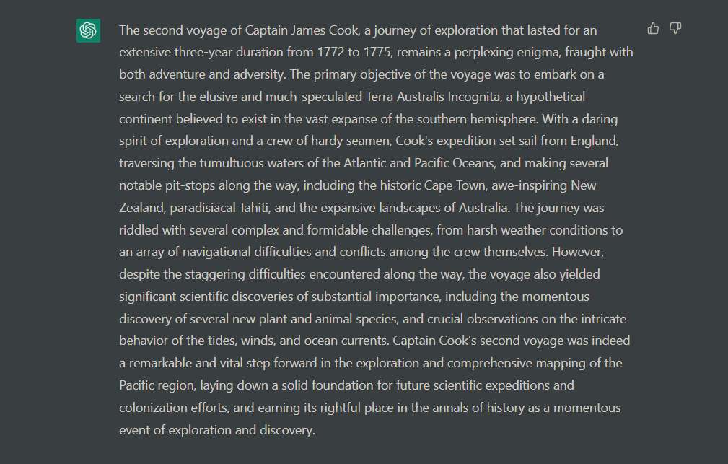

Slide 11
Prompt 3
Above is the text I want to learn about. Please write 5 multiple choice questions about the text. Feed only ONE and ONE QUESTION at a time, and don't show the answer. Number each question. Automatically feed the next question at the end of your response.
Quiz Maker
A two-part prompt
A writing improver

Slide 12
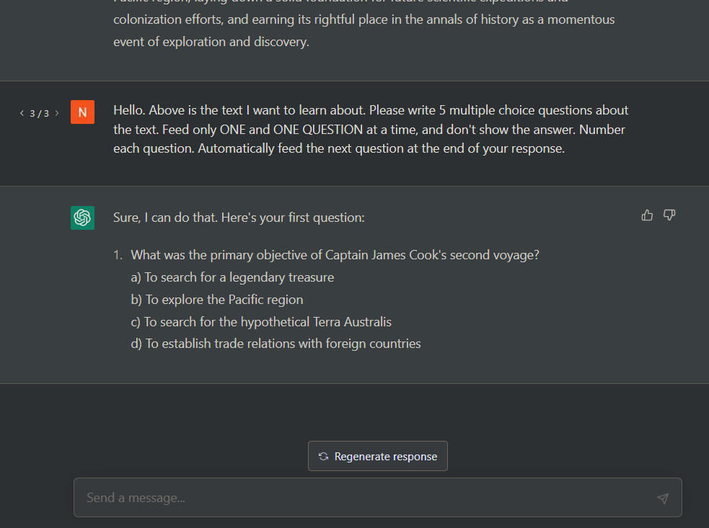

Slide 14
Thank You
Yuri Gushiken
yurigushiken2@gmail.com

Slide 15
The way to get started is to quit talking and begin doing.
Walt Disney

Slide 16
Team
Name
Name
Name
Name
Title
Title
Title
Title

Slide 17
Timeline

Slide 18
Possibilities
No regulation –
Drug companies will have medical breakthroughs that prove safe and effective through simulation

Slide 19
Content
SUBTITLE
SUBTITLE
Add text, images, art, and videos.
Add transitions, animations, and motion.
Save to OneDrive, to get to your presentations from your computer, tablet, or phone.
Open the Design Ideas pane for instant slide makeovers.
When we have design ideas, we’ll show them to you right there.

Slide 20
Summary
With PowerPoint, you can create presentations and share your work with others, wherever they are. Type the text you want here to get started. You can also add images, art, and videos on this template. Save to OneDrive and access your presentations from your computer, tablet, or phone.

