Slide 1
UI Tips and Tricks
Level 6+ Class
Android / iOS Tips and Tricks

Slide 2
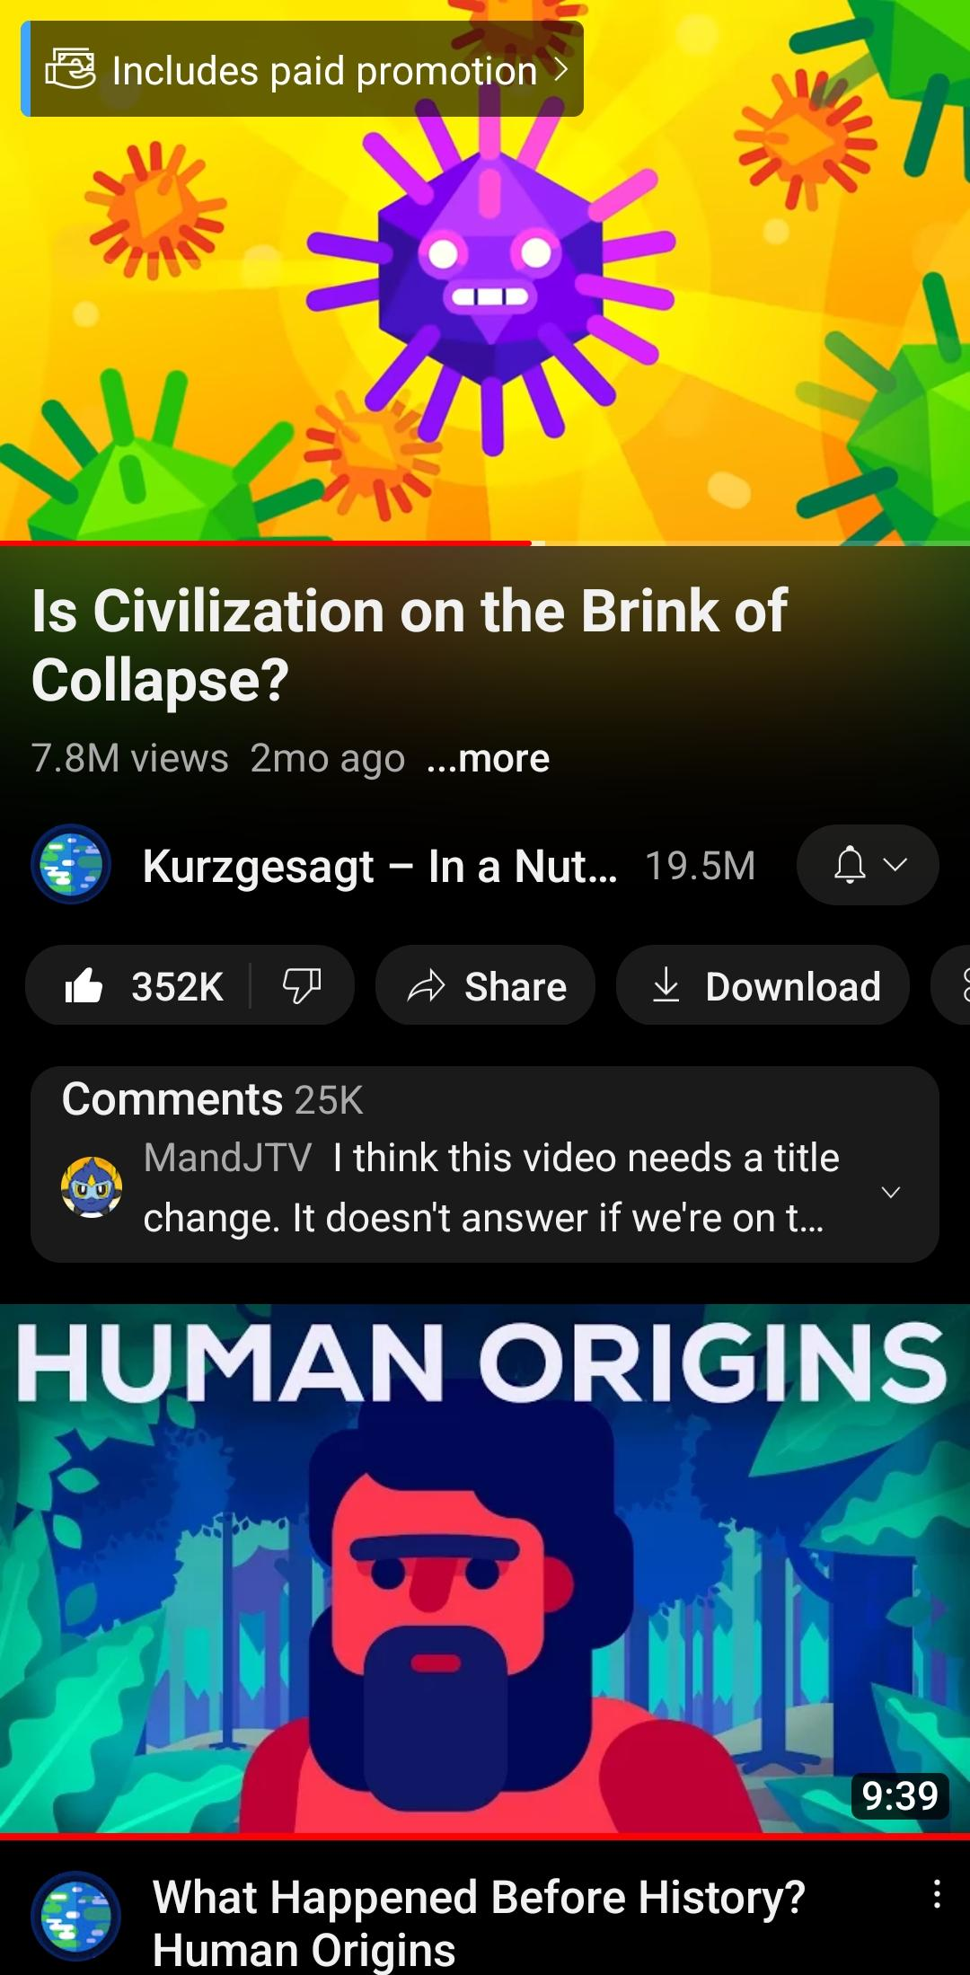
What is a UI?
UI means “user interface”
“a user interface is the space where interactions between humans and machines occur”
Operating systems, programs, and applications have UIs.
UIs are usually updated
UIs usually have settings that we can adjust/change

Slide 3
Make New Friends
What’s your name?
How much do you use your phone?
(only in the evening, before work and after work, all the time)
What’s your favorite “hidden” or “secret” feature in an app?
What feature do you use or know about that a lot of people don’t know about?
Do you use a sleep timer for music/audio?

Slide 4
Make New Friends
His name’s ________
He uses his phone at lunch time and after work.
He uses a sleep timer / He doesn’t use a sleep timer
What’s your name?
How much do you use your phone?
(only in the evening, before work and after work, all the time)
What’s your favorite “hidden” or “secret” feature in an app?
What feature do you use or know about that a lot of people don’t know about?
Do you use a sleep timer for music/audio?

Slide 6
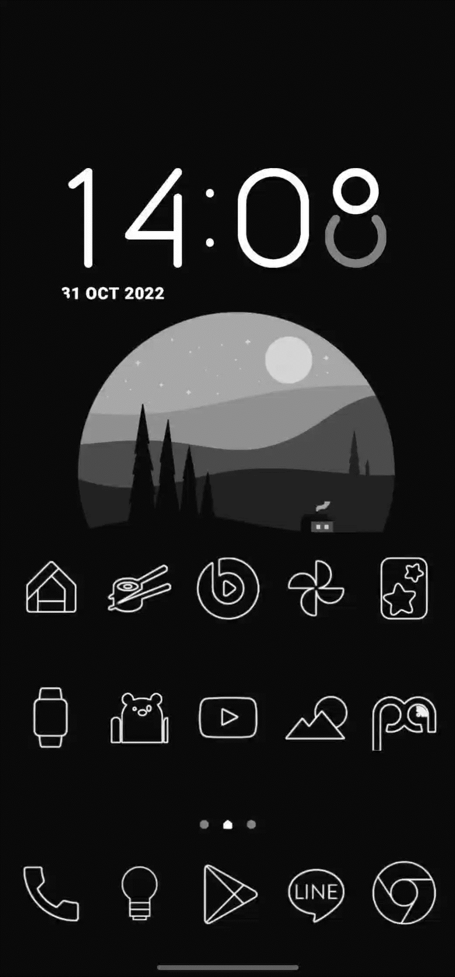
How to enable dark background in Chrome
Why? So it’s easier on your eyes when you browse.
Open chrome
Select enabled
Open the first menu
Search the word “dark”
Try a webpage
Relaunch Chrome
Type “chrome://flags” hit enter
Select enabled
Open the next menu

Slide 7
How to enable dark background in Chrome
Why? So it’s easier on your eyes when you browse.
Open chrome
Type “chrome://flags” hit enter
Search the word “dark”
Open the first menu
Select enable
Open the next menu
Select enable
Relaunch Chrome
Try a webpage

Slide 8
Regroup

Slide 9
Share a UI tip or trick
Meet your new partner(s)
Share a UI tip or trick
You can share something you already use, or you can find a tip/trick online
Decide whose tip or trick you want to share (or choose both)
Write a title and instructions

Slide 10
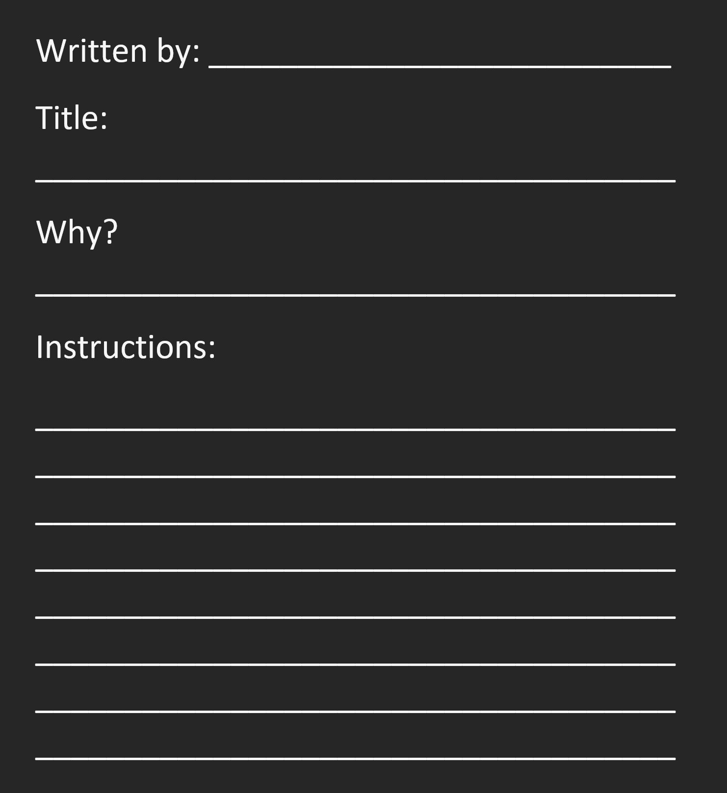
Regroup

Slide 11
Written by Yuri
How to enable dark background in Chrome
Why? So it’s easier on your eyes when you browse.
Open chrome
Type “chrome://flags” hit enter
Search the word “dark”
Open the first menu
Select enable
Open the next menu
Select enable
Relaunch Chrome
Try a webpage
example
Helpful verbs:
Scroll up
Scroll down

